Slide 1
Speaker: Arlan McMillan
Arlan McMillan is the Chief Security Officer (CSO) for Kirkland & Ellis LLP. Kirkland is an international law firm that serves a broad range of clients around the world in private equity, M&A and other corporate transactions, litigation, white collar and government disputes, restructurings and intellectual property matters. Office locations include the US, UK, France, Germany, China & Hong Kong.
As the CSO, Arlan oversees the strategy and delivery of Cyber Security, Physical Security, and Business Continuity Management capabilities firm wide. With over 25 years’ experience in Information Technology and Security, Arlan has led several teams developing and delivering security services for top organizations including United Airlines, the City of Chicago and ABN Amro Bank.
Prior to joining Kirkland, Arlan was a board member of the Aviation Information Sharing and Analysis Center (A-ISAC) and the Transportation Sector Chief for the FBI-InfraGard Chicago region.
He is currently serving as the Chair for ChicagoFIRST, an Executive Committee member of the CyberSecurity Collaborative, and a is regular contributor on the topics of risk management and executive communications.
arlanmcmillan@protonmail.com
Security in radical change
The views expressed here are mine alone and not necessarily those of my employer or GCSI.

Slide 2
Your take-a-way
How to win in cyber security (and life)

Slide 3
The pace of change is slowest now than it will be in your lifetime

Slide 4
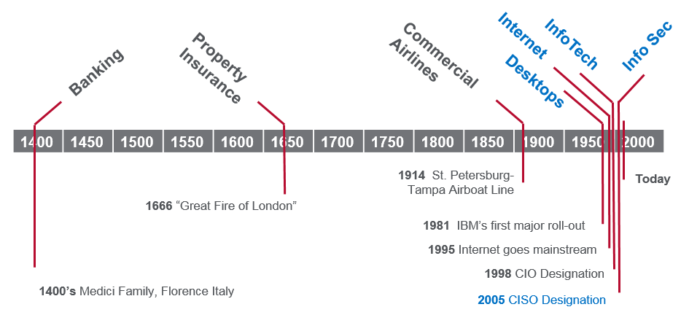

Slide 5
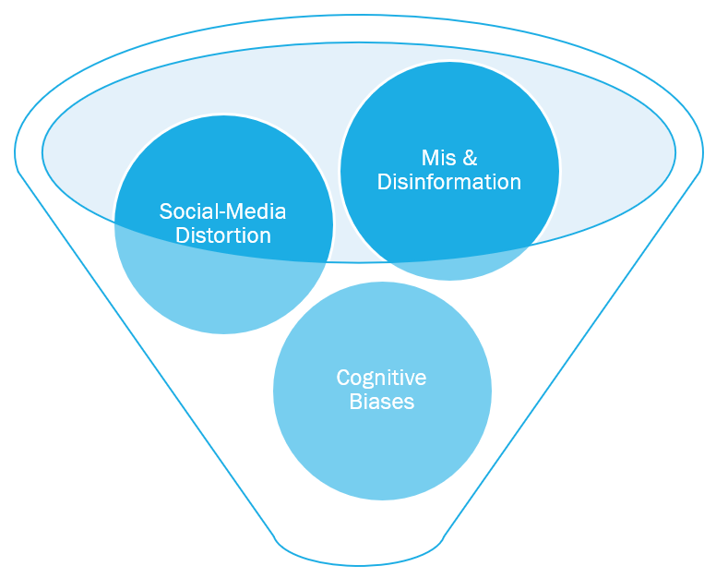
Your brain can’t handle it
Critical Thinking &
Systemized Approaches

Slide 6
Most cyber security programs fail

Slide 7
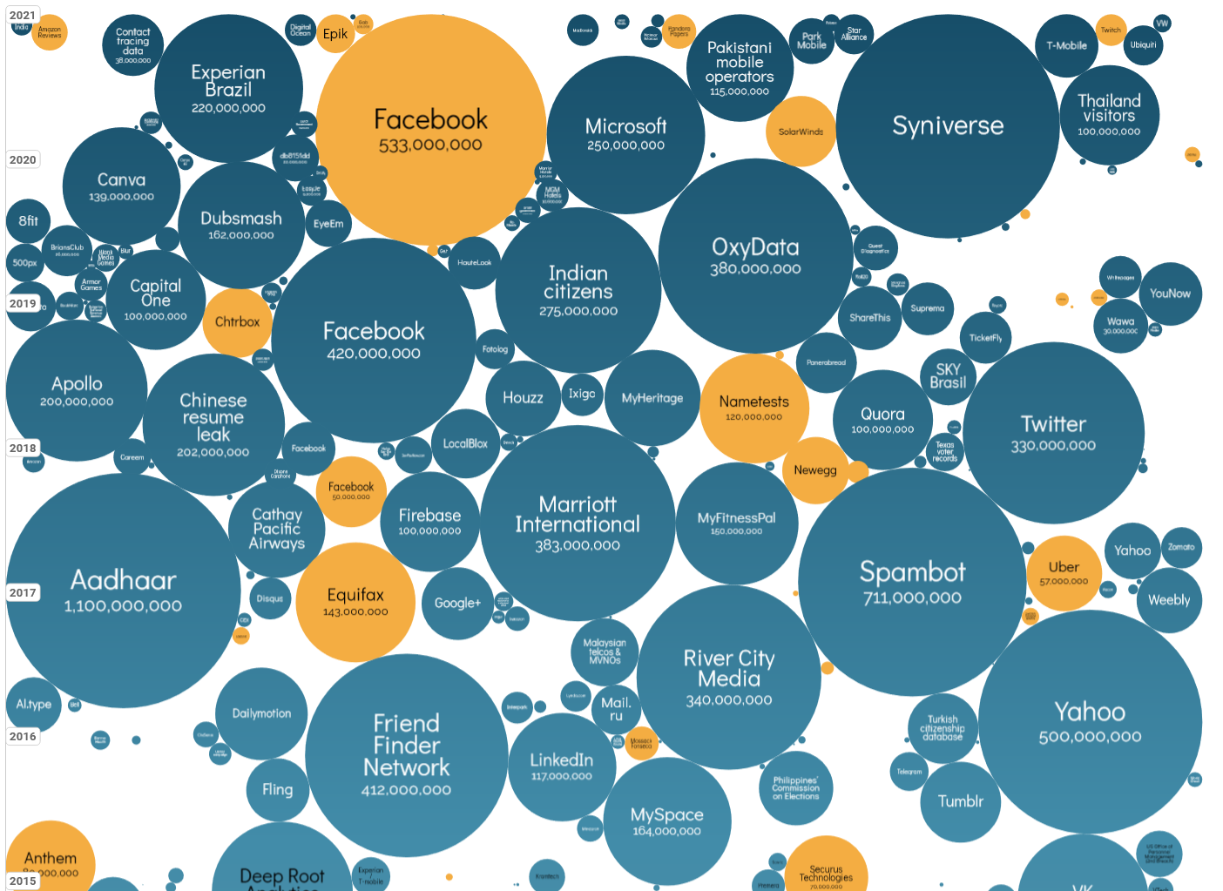
World’s biggest data breaches & hacks 2016 – 2021 6 years
2021
2020
2019
2018
Largest breaches by records lost
2017
2016
source: https://www.informationisbeautiful.net/visualizations/worlds-biggest-data-breaches-hacks/

Slide 8
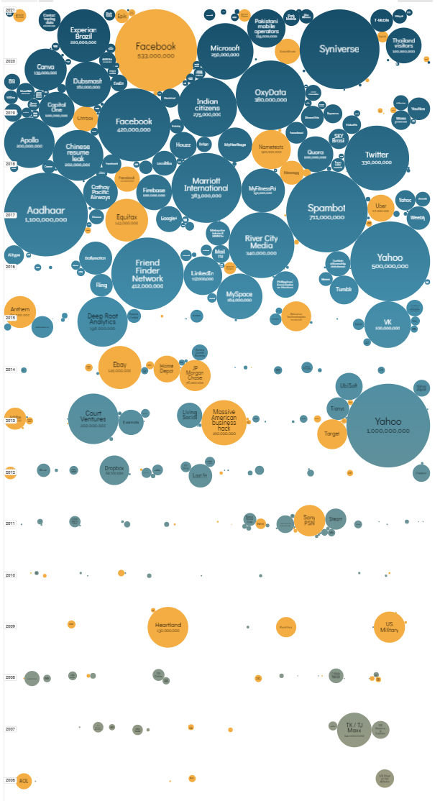
World’s biggest data breaches & hacks 2004 – 2021 17 years
2021
2016
More frequent
More impactful
More costly
2004

Slide 9
Poor cyber security impacts the bottom line
Increased insurance premiums and coverage loss
Financial costs (direct & indirect)
Operational downtime
Brand reputational
Lower customer retention
Decreased organizational agility

Slide 10
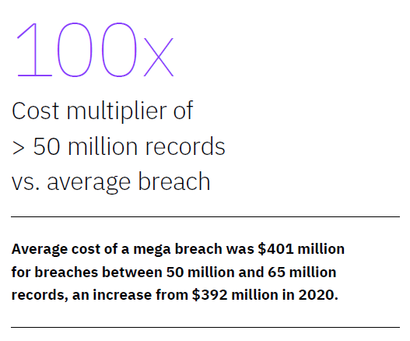
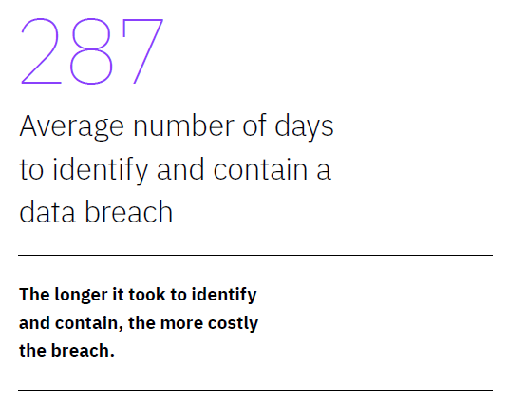
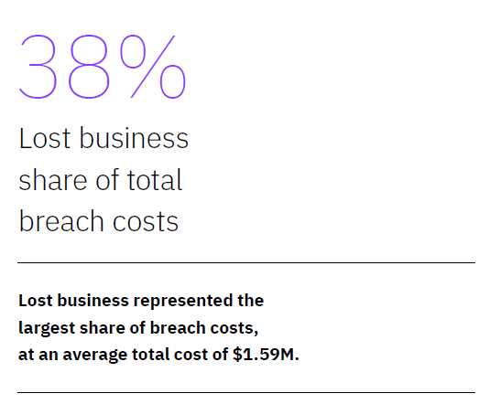
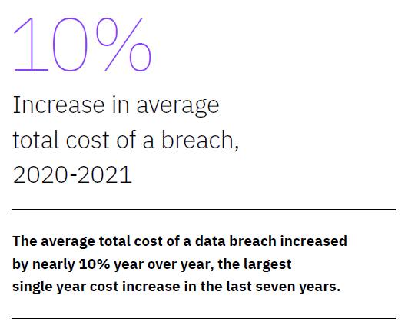
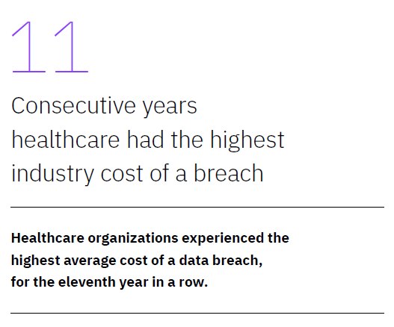
source: Cost of Data Breach Report 2021, IBM and Ponemon Institute

Slide 11
assertion
The vast majority of Cyber Security Programs (CSPs) do not meet business executive’s expectations and are not responsive to the modern threat landscape.
Underfunded, Not effective (enough), Reactive not proactive
… and the primary reason is because CISO’s aren’t doing the basics
fundamental hygiene
measuring & communicating effectively

Slide 12
In times of radical change, managing the basics is everything

Slide 13
CIS-18 & Fundamental hygiene
Inventory Assets Inventory Software Data Protection Secure Configuration Account Management Access Control Mgmt. Vulnerability & Patch Mgmt. Audit Log Mgmt. Email & Web Browser Protections | Malware Defenses Data Recovery Network Infrastructure Network Monitoring & Defense Security Awareness & Training Service Provider Mgmt. Application Software Sec. Incident Response Mgmt. Penetration Testing
Notes:
State Department 88% reduction of vulnerability risk in first year of implementation

Slide 14
CIS-18 & Fundamental hygiene
Inventory Assets Inventory Software Data Protection Secure Configuration Account Management Access Control Mgmt. Vulnerability & Patch Mgmt. Audit Log Mgmt. Email & Web Browser Protections | Malware Defenses Data Recovery Network Infrastructure Network Monitoring & Defense Security Awareness & Training Service Provider Mgmt. Application Software Sec. Incident Response Mgmt. Penetration Testing

Slide 15
Ransomware VS HYGIENE
RANSOMWARE Unpatched Vulnerability (70%) Open / Weak RDP (20%) User as Admin on Endpoint (5%) | HYGIENE 7. Vulnerability & Patch Mgmt. 12. Network Infrastructure 4. Secure Configuration 9. Email & Web Browser Protect. 10. Malware Defenses

Slide 16
cyber security as a process

Slide 17
Systemize your tactics and strategy
Use frameworks (CIS-18 & NIST CSF)
Understand that Cyber security is fundamentally an Enterprise Risk Management discipline
3 Key Questions (distilled from NACD 5 Principles)
Is overall cyber risk posture aligned to the Firm’s / Company’s risk appetite?
Are there any material risks that need to be addressed?
Are we spending the right amount on security?
Cyber Security Program = (Threats – Capabilities) + Strategic Drivers

Slide 18
typical cyber security program development methods
AD HOC
QUALITATIVE
QUANTITATIVE
A list of projects developed by the CISO – “Because I said so”
Reactive and not part of a coherent and understood plan
Easy to ignore or “downplay”
Driven by outside requirements – compliance and/or client demands
Difficult for non-technical executives to understand the importance of individual projects
No clear linkages to wider company strategic goals
CMMI (Capability Maturity Model Integration) - Ranks processes and/or broad domains from 1-5 (Initial, Managed, Defined, Managed, Optimizing)
Standard NIST CSF - Ranks Functions and Categories 1-4 (Partial, Risk Informed, Repeatable, Adaptive)
Scenario Planning – A hybrid method which uses common scenarios to illustrate the potential impact of a cyber incident
Typically performed through interviews of key SMEs and Stakeholders
Peer comparisons
Often used by consulting groups
Highly dependent on the skills of the assessor
Tactical Service Level Metrics – incident counts, MTTR, patch status, etc.
FAIR (Factor Analysis of Information Risk) – A risk analysis model that specializes in financially derived results tailored for enterprise risk management
Monte Carlo Simulation – A mathematical model that focuses on developing a range of possible outcomes and the probabilities they will occur for any choice of action
Requires “longitudinal” data that for the most part doesn’t exist and/or is difficult to accurately collect
False precision can lead to distrust

Slide 19
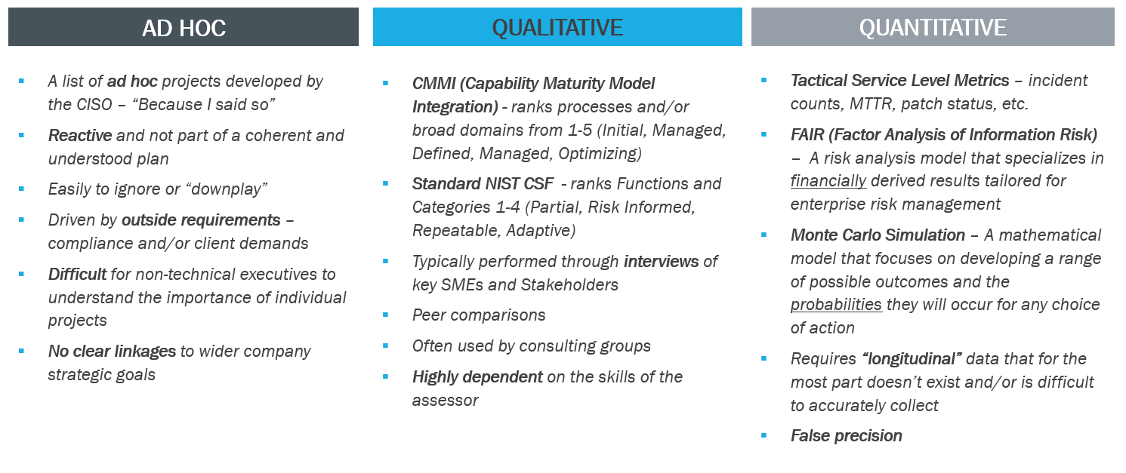
hybrid risk assessment & program development process
HYBRID
Modified NIST CSF - leverages “Weights” and “Scores” (current vs target) to assess risk and importance
Combination of qualitative, quantitative & scenario planning techniques
Accepts that there is inherent subjectivity in risk assessment process
Easier to perform by internal groups
Rapid to deploy – less than 3 weeks
Developed over 12 years
Tested & validated at many Fortune-50 companies

Slide 20
comprehensive Cyber security Program (CSP) development
(T – C) + SD = CSP
Gaps Prioritized
Threat Assessments
Capabilities Assessments
Strategic Drivers
1
Identify adversary’s likely targets of interest
Responding to evolving threat landscape
Incident Response
Treatment Plans Developed
(remediate, accept, defer, etc.)
Modified CSF - Alignment to industry good practice frameworks (NIST Cyber Security Framework (CSF))
Engage outside experts to validate assumptions
Testing / simulated hacking (Penetration Testing)
Develop business continuity plans (BCP)
Train for confident cyber incident response (CIRT)
2
Project 1
Define risk tolerance (current vs target risk posture)
Evaluate potential loss scenarios (operational, financial, reputational, etc.)
Develop solutions to address specific business needs
Compliance to regulatory and industry standard frameworks (PCI, HIPAA, ISO, SOC)
3
Project 2
Project 3
Notes:
Is this aligned with other peoples methodologies?

Slide 21
Modified csf

Slide 22
Modified CSF
5 Functions (Identify, Protect, Detect, Respond, Recover)
23 Categories
108 Subcategories
Control Frameworks (ISO 27001, NIST 800-53, Cobit, etc.)
A structure to organize cyber security activities
CSF widely adopted as leading standard
Modified to include
Interview based scoring system for rapid assessments
Weights by subcategories to define what’s important to your organization
Targets by subcategory to better identify gaps and build projects
Notes:
5 Functions > 23 Categories > 108 Subcategories > Controls

Slide 23
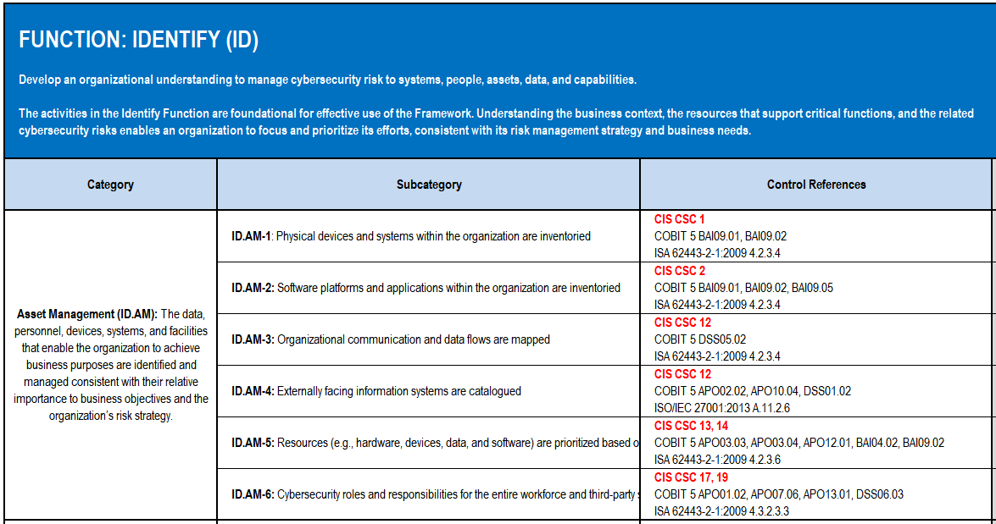
5 FUNCTIONS
(Identify, Protect, Detect, Respond, Recover)
6 CONTROL FRAMEWORK REFERENCES
(NIST 800-53, CIS CONTROLS, ISO 27001)
23 CATEGORIES
108 SUBCATEGORIES

Slide 24
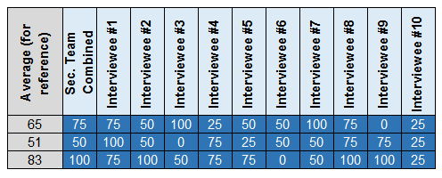
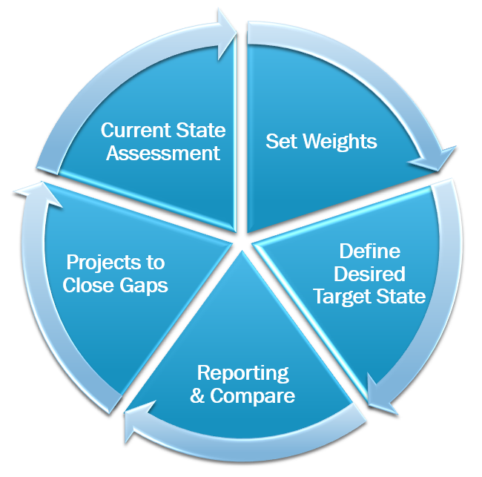
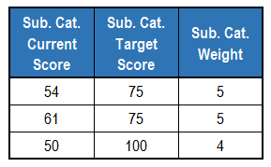
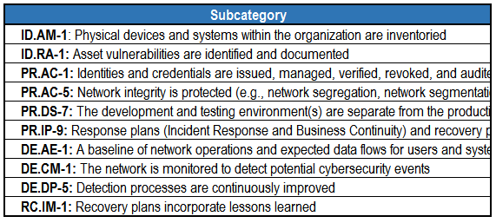
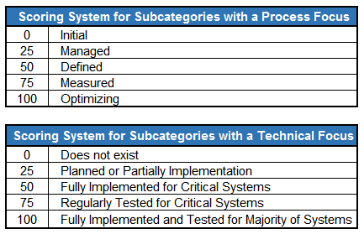
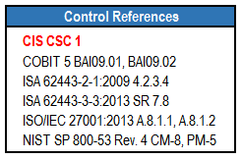
Defining risk posture

Slide 25
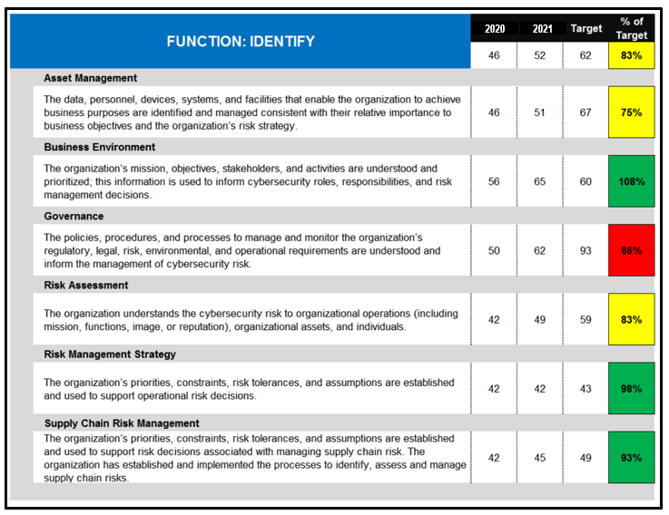
look at the subcategories for specific gaps to address through projects
ID.AM-4: Externally facing information systems are catalogued

Slide 26
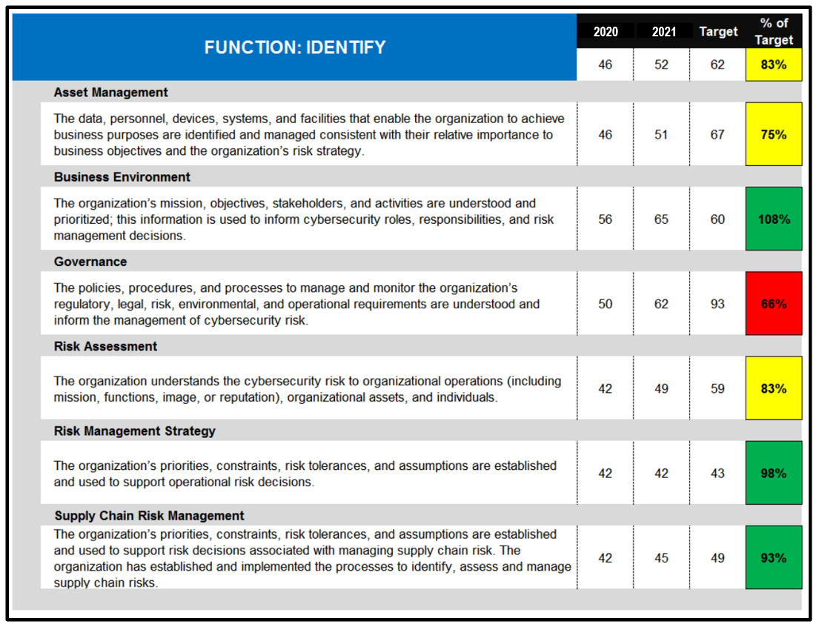
Score roll-up to categories
5 Functions > 23 Categories > 108 Subcategories > Controls
Current vs Target
% of Target
Weights
Traceable
Transparent
Defendable
More than just…
“Because I said so”
Notes:
Not going to dri

Slide 27
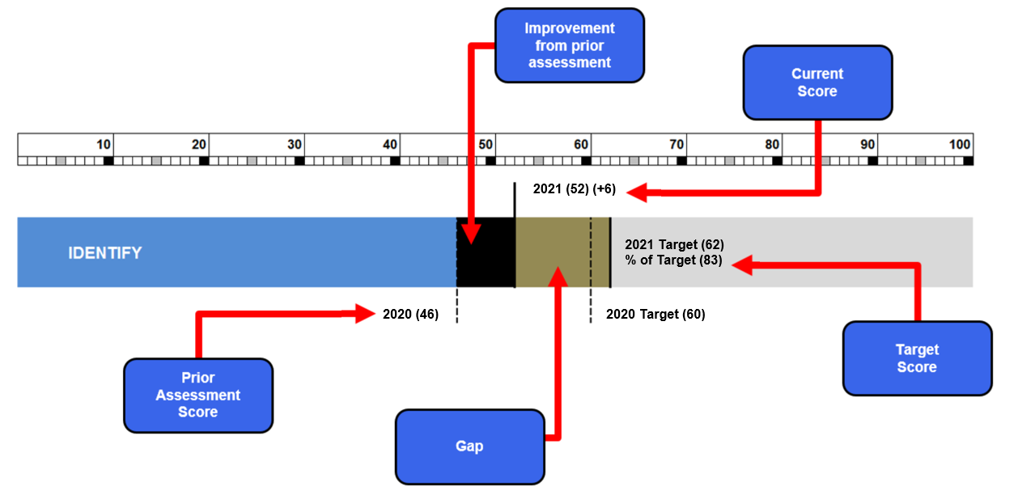
Target scores are set based on assumed risk and overall organizational risk tolerance
Set a 3-year future target
100 or “perfect” Target score is rarely desirable

Slide 28
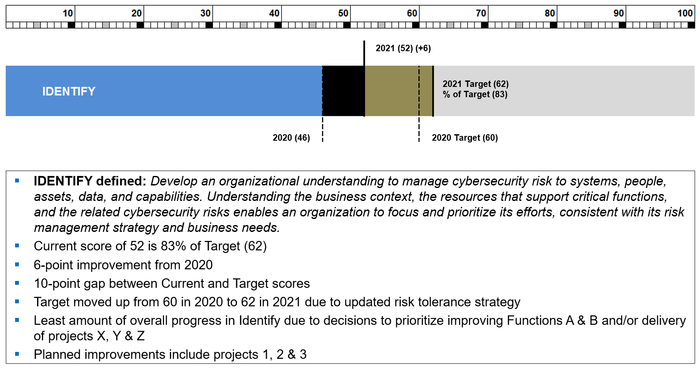

Slide 29
Recap
Risk is the language of Executives
Systematic approach beats cognitive bias and scare tactics
Define Current and Target states
“Because I said so” isn’t enough – your security program must be rooted in a defendable, transparent and traceable methodology

Slide 31
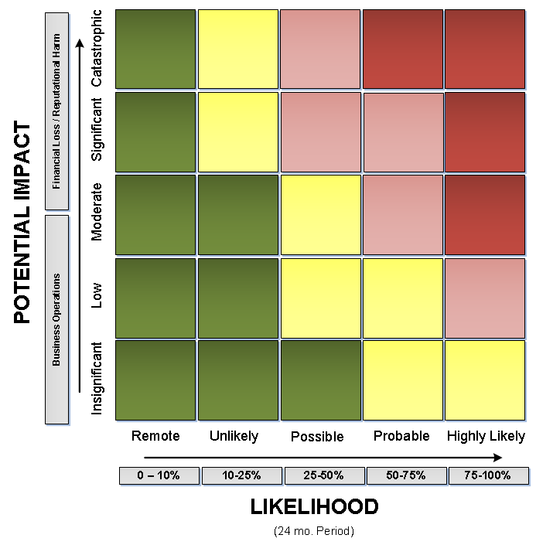
Scenario based risk tracking
REF | (Likelihood / Impact*) Description
01 | (U/C) Endpoint compromise by external actor leads to compromise of multiple internal systems and acquisition of root / domain administrator account credentials. As these accounts allow for the highest level of access and wide scale control of the IT infrastructure, multiple catastrophic results could occur if they were abused.
02 | (U/S) Endpoint compromise of sensitive user (Sr. Executive, etc.) by external actor which leads to the access of an individual’s complete email history, data harvesting and exfiltration.
03 | (U/M) Endpoint compromise followed by a cryptographic ransom and/or data destruction attack against core computer systems.
04 | (P/M) External actor accesses externally facing website and embeds malware which compromises visitors to site.
05 | (H/L) Insider harvesting significant volumes of data and exfiltration prior to joining competitor.
01
02
03
04
05
* Intent of malicious actor(s) can introduce significant variability in the actual impact of a successful attack. As intent is often difficult to predict, Potential Impact ratings reflect most likely scenarios.

